Slide 1
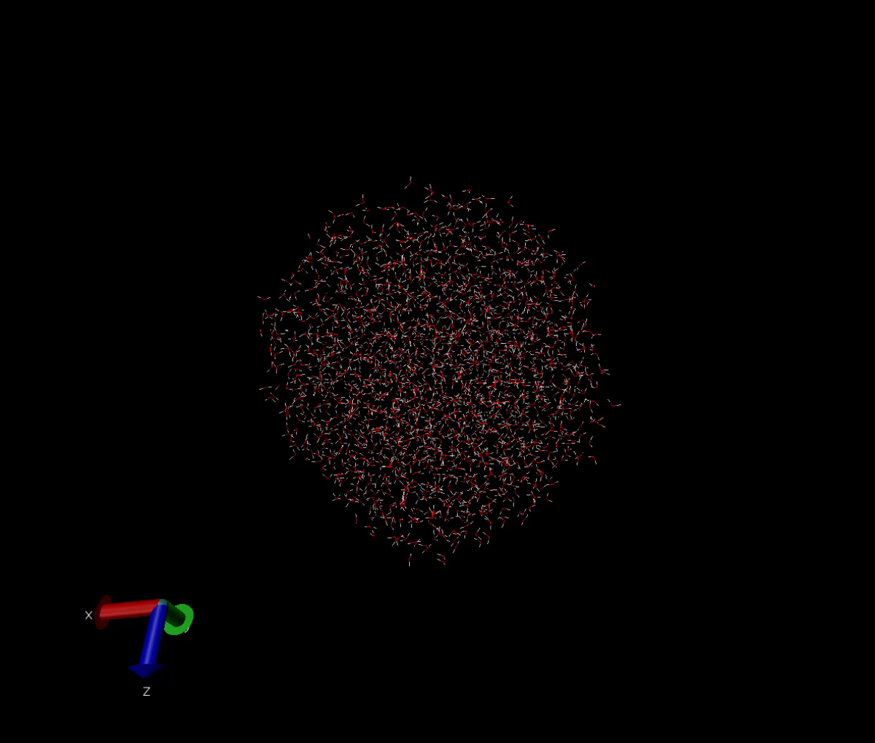
Simulating water
Asela Chandrasinghe

Slide 2
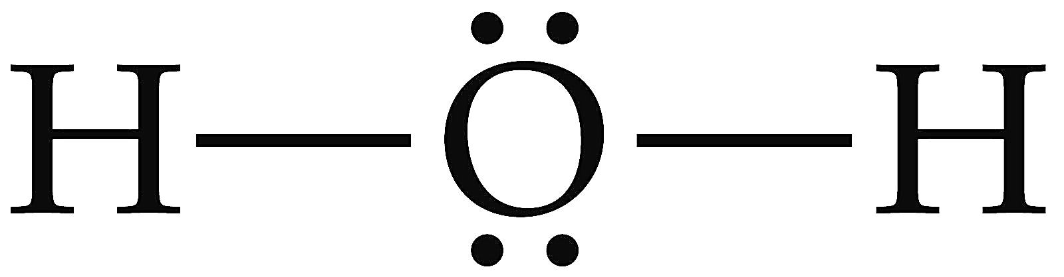
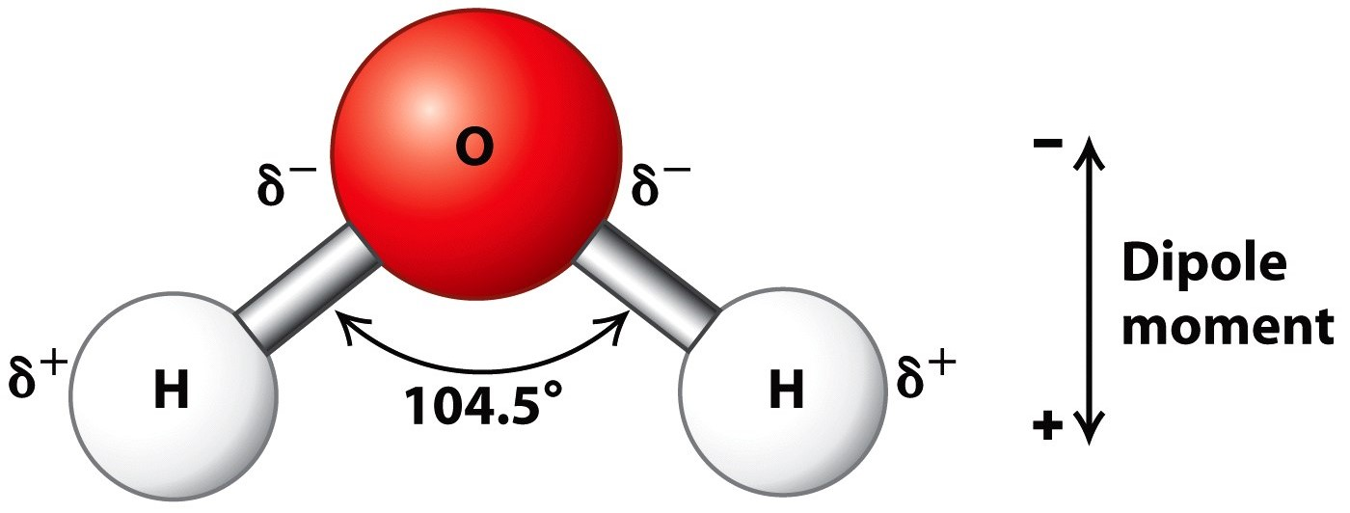
Water Structure
2 lone pairs
Bent geometry
Covalent bonds
Partial charges
Hydrogen bonding
https://alevelbiology.co.uk/notes/water-structure-properties/
http://wt.kimiq.com/lewis-dot-diagram-for-water/

Slide 3
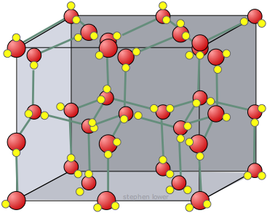
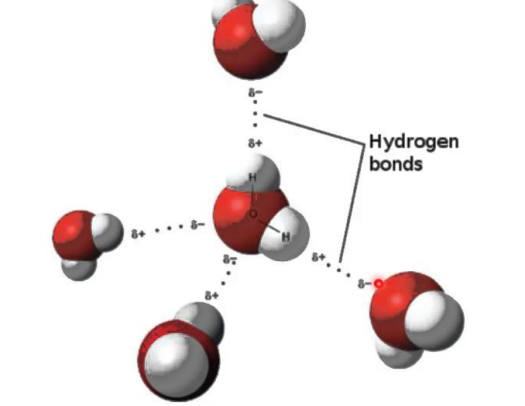
Water PRoperties
https://socratic.org/questions/how-is-hydrogen-bonding-among-water-molecules
https://chem.libretexts.org/Textbook_Maps/General_Chemistry_Textbook_Maps

Slide 4
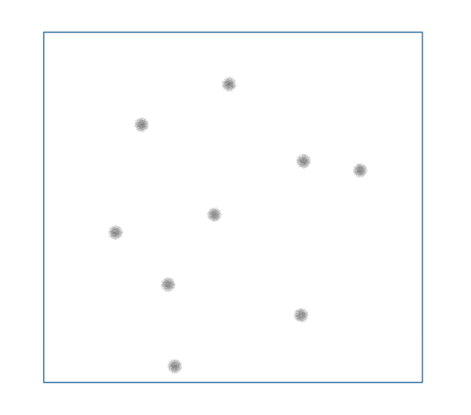
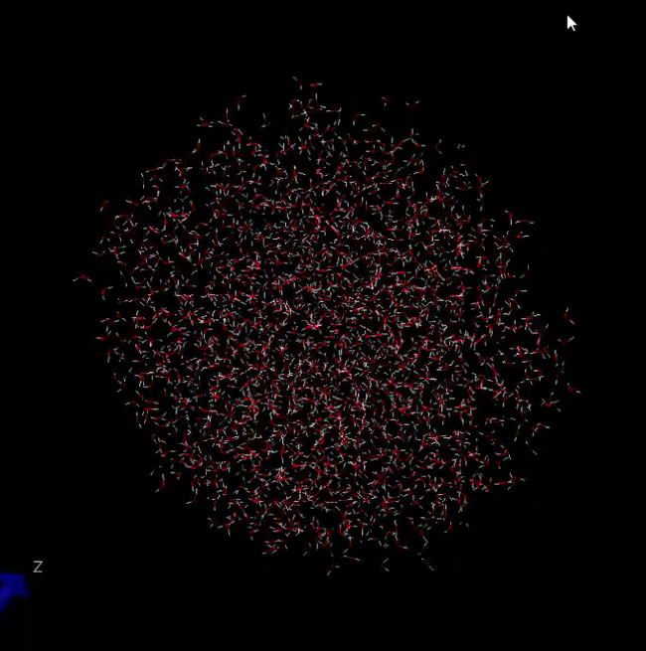
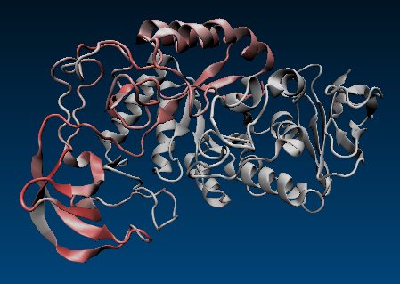
MOLECULAR DYNAMICS

Slide 5
Project purpose

Slide 6
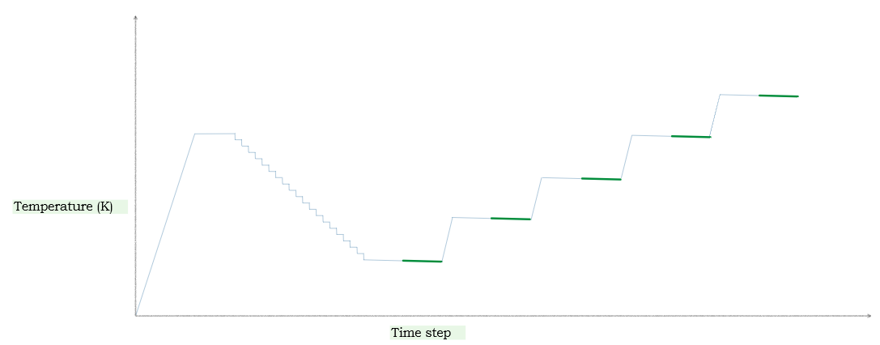
Simulation setup
400K
300K
350K
300K
250K
200K
*not to scale

Slide 7
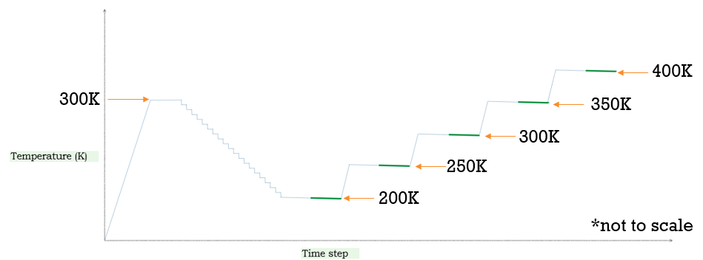
Simulation 1
Simulation 2
2,000 molecules
Annealing in 105,000 time steps
10,000 steps at 300K
5,000 steps at each temp going down
Equilibrate 6,000
Collect every 50 steps for 8,000 steps (160 samples)
8,937 molecules
Annealing in 11,500 time steps
2,000 steps at 300K
500 steps at each temp going down
Equilibrate 1,000 steps
Collect every 40 steps for 4000 steps (100 samples)

Slide 8
Model parameters
Forces (Ameoba)
Integration method
Intermolecular
van der waal
dipole-dipole
charge- charge
quadrupole
Intramolecular
bond stretching
bond bending
Langevin integrator
Verlet method
Newtons equations of motion replaced with Langevin equations of motion

Slide 9
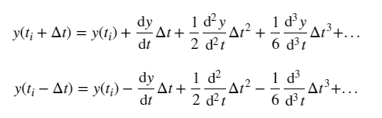
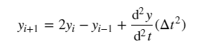
Verlet Method
Taylor expansion forward direction
Taylor expansion backward direction
Forward + backward

Slide 10
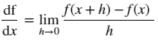
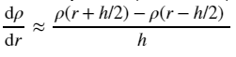
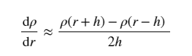
Numerical Method numerical derivative
Derivative Definition
Central Difference
Numerical Derivative Applied

Slide 11
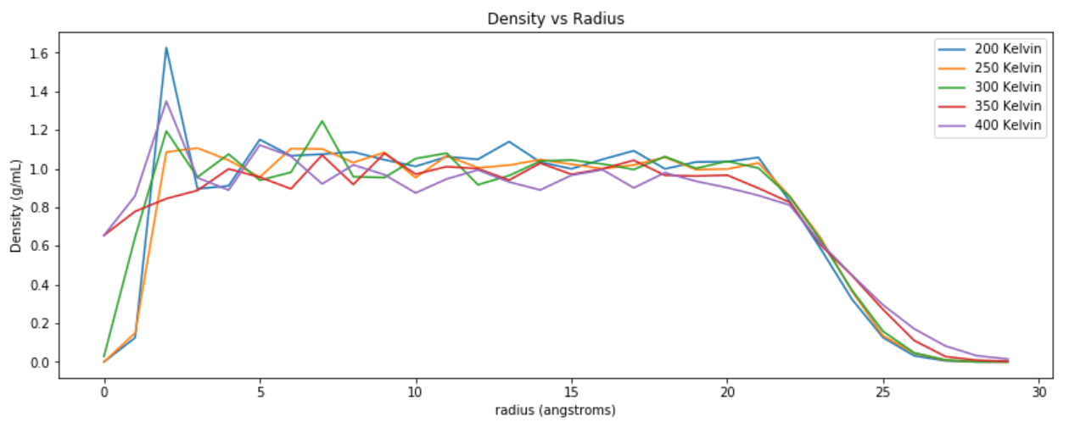
Results

Slide 12
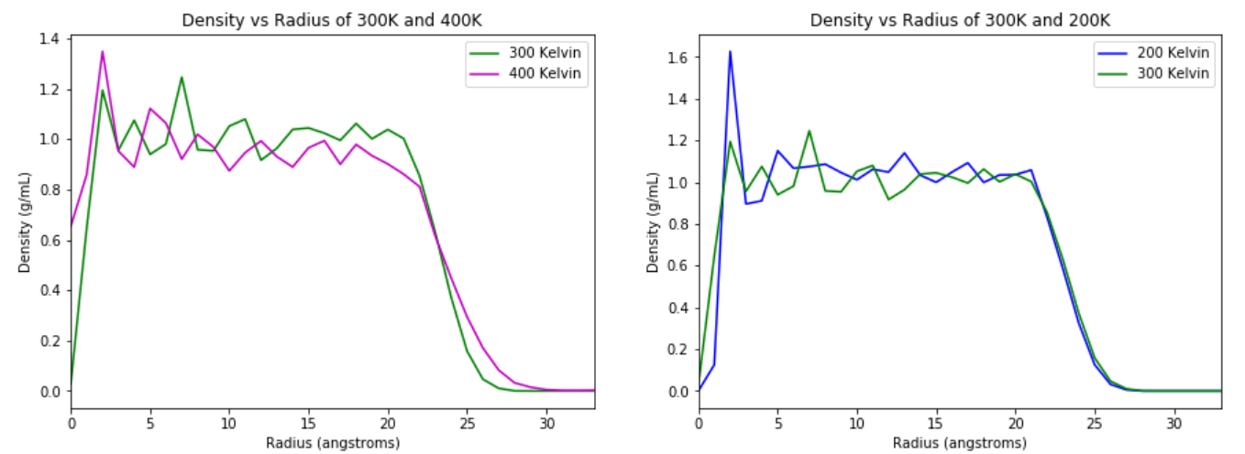

Slide 13
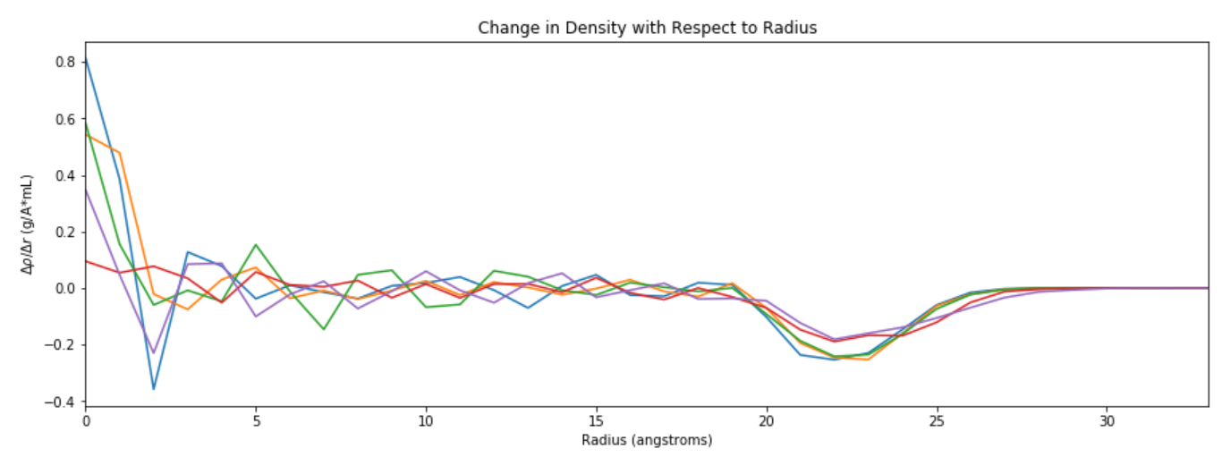

Slide 14
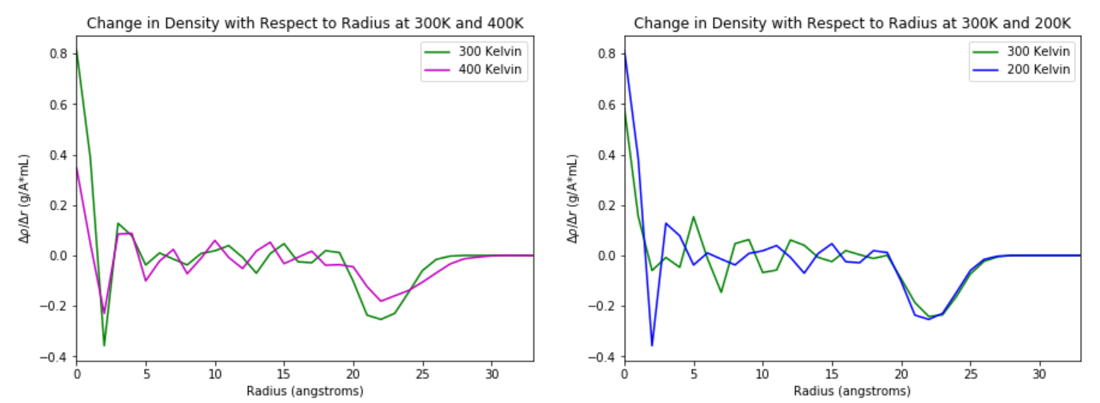

Slide 15
Future work
Notes:
I poured a lot of work into this project and I’ve worked hard on it for the last month. IT has become my baby of sorts but there are lots of opporturnity for growth.

Slide 16
Work Cited
Atkins, P. Physical Chemistry: Thermodynamics, structure, and change; Macmillan Higher Education: 2014; .
Ponder, J. W.; Wu, C.; Ren, P.; Pande, V. S.; Chodera, J. D.; Schnieders, M. J.; Haque, I.; Mobley, D. L.; Lambrecht, D. S.; DiStasio Jr, R. A. Current status of the AMOEBA polarizable force field. The journal of physical chemistry B 2010, 114, 2549-2564.
Schiller, U. D. An overview of integration schemes for molecular dynamics simulations. Lecture note 2008.
Giordano, N. J. Computational physics; Pearson Education India: 2006; .
Eastman, P.; Swails, J.; Chodera, J. D.; McGibbon, R. T.; Zhao, Y.; Beauchamp, K. A.; Wang, L.; Simmonett, A. C.; Harrigan, M. P.; Stern, C. D. OpenMM 7: rapid development of high performance algorithms for molecular dynamics. PLoS computational biology 2017, 13, e1005659.
Perlman, H.; USGS. The water in you https://water.usgs.gov/edu/propertyyou.html (accessed May 12, 2018).
Martinez, L.; Andrade, R.; Birgin, E. G.; Martinez, J. M. PACKMOL: a package for building initial configurations for molecular dynamics simulations. Journal of computational chemistry 2009, 30, 2157-2164.

Slide 17
Awknowledgements
Dr. Kevin Johnson
Dr. Danielle McDermott

